Slide 1
Autonomous car
Sabry Mohamed Sabry
Kareem Mohamed Anwer
Ahmed Mohamed Abdelaziz
Mahmoud Mohamed Abdallah
Abdelrahman Emad Ibraim
GitHub link: https://github.com/sabry112002/Autonomous-car

Slide 2
At first The car initially moves to forward. in case the car show obstacle by ultra sonic : 1- the servo motor moves left subsequently the ultrasonic measures the distance at the left of the car. the servo motor moves right subsequently the ultrasonic measures the distance at the right of the car. The car compares the two measured distances. 2- in case the left distance is greater than right distance: the car moves left and then forward [the direction will be displayed on the lcd]. in case the right distance is greater than left distance: the car moves right and then forward [the direction will be displayed on the lcd]. in case both direction are less than 20 the car moves back and then measures right and left distances.

Slide 3
Components:
1. Ultrasonic HC- SR04.
2. Servo motor.
3. L293D.
4. 4WD RC CAR

Slide 4
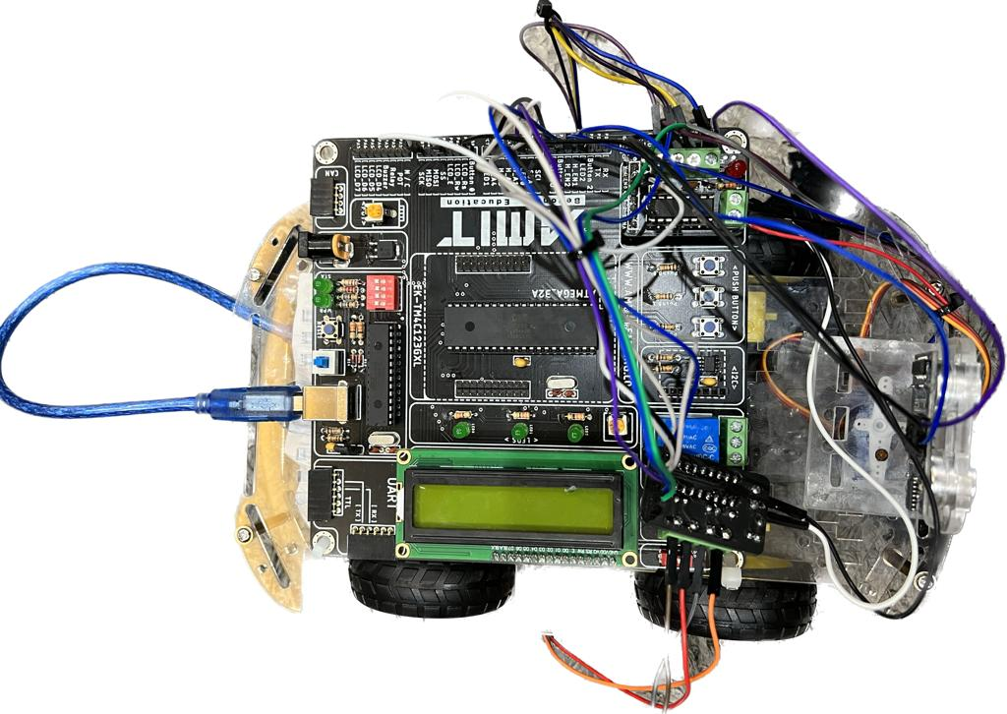
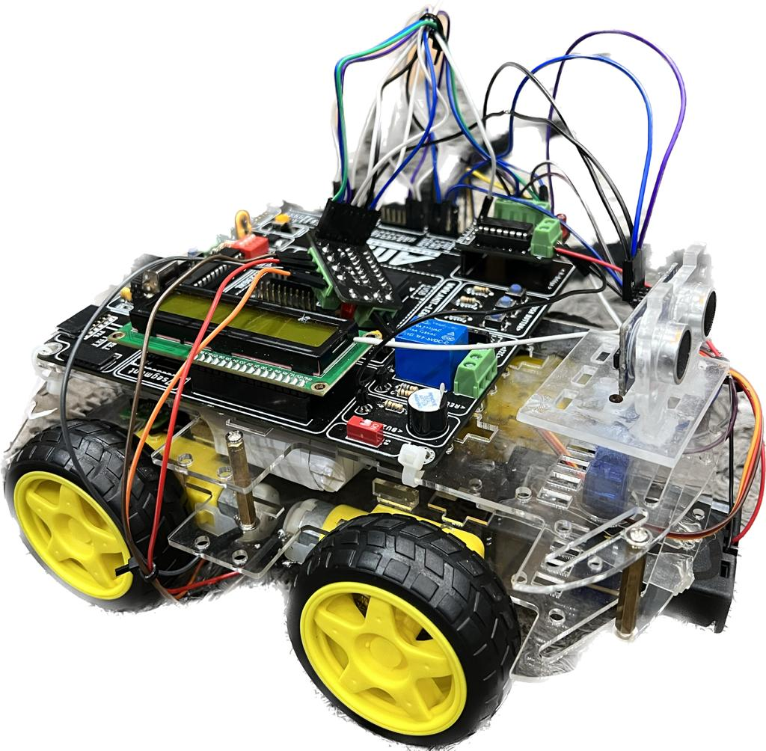

Slide 5
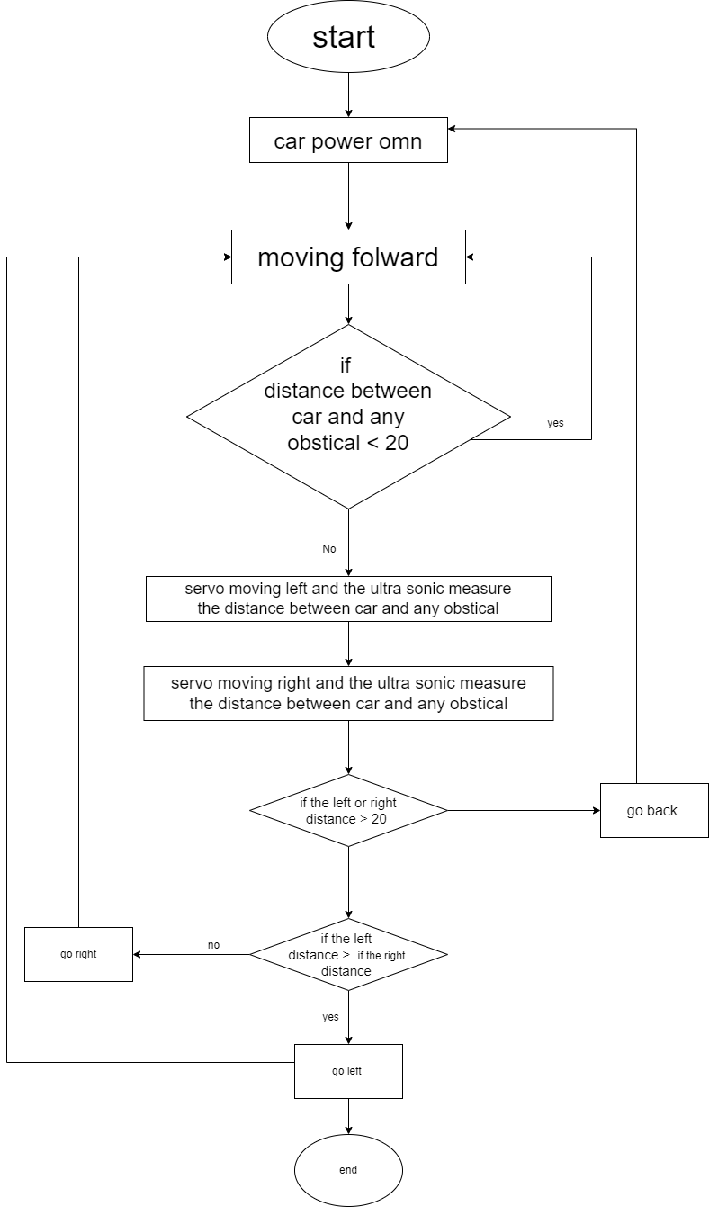
Flow chart

